Slide 1

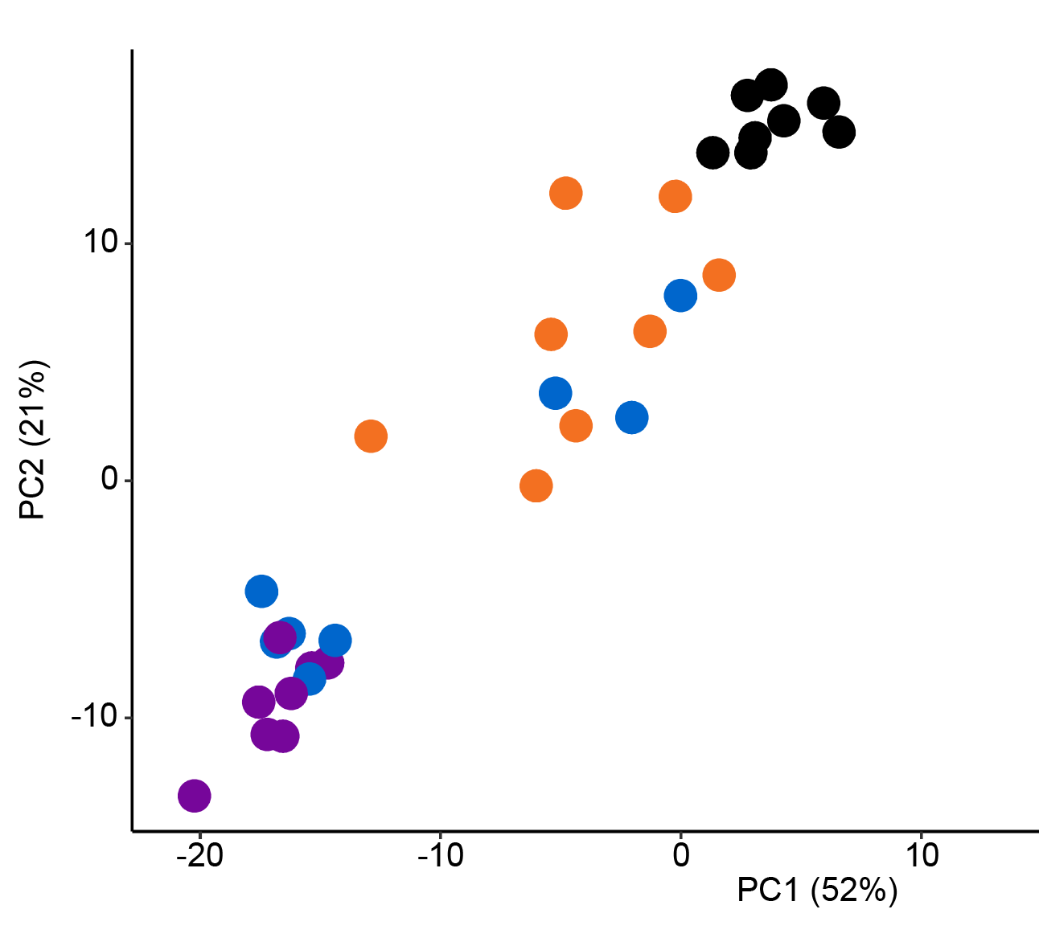

GLP-1/Glucagon Dual Receptor Agonist ALT-801 is Superior to Semaglutide in Improving NASH Endpoints in a
Biopsy-Confirmed DIO Mouse Model
JJ Nestor¹, K Rigbolt², M Feigh², D Parkes³, MS Harris¹, 1. Altimmune, Inc., Gaithersburg, MD; 2. Gubra, Horsholm, Denmark; 3. DGP Scientific, Del Mar, CA
Background
Results
more NASH pathways differentially regulated
modulation of genes affecting fat usage and transport
NASH and NAFLD
hepatic manifestations of obesity and metabolic syndrome
Body weight returns to chow-fed lean normal range
carnitine palmitoyl-
transferase 1a (CPT-1)
fatty acid synthase
(FASN)
gycerol-3-phosphate
acyltransferase 2 (GPAT2)
Body weight loss of 10% or greater improves the metabolic derangements and liver disease in most NASH patients, suggesting metabolic modulators may be effective in the control of the disease (Vilar-Gomez 2015).
GLP-1 agonists show promise for NASH, but weight loss associated with these agents at approved doses is modest and associated with side effects (Armstrong 2016, Gomez-Peralta 2019, Nauck 2019).
Glucagon receptor activation has direct effects on lipolysis, basal energy expenditure and liver lipid metabolism and may act synergistically with GLP-1 in the treatment of obesity and NASH (Day 2012).
25%
ALT-801
10 nmol/kg
glycerol-3-phosphate
acyltransferase 4 (GPAT-4)
peroxisome proliferator
activated receptor α (PPAR α)
peroxisome proliferator
activated receptor δ (PPAR β)
5435
Total regulated genes
ALT-801 10nmol/kg ~ 8,000
semaglutide 10nmol/kg ~ 2,800
vehicle
chow-fed lean normal range
2592
ALT-801 5 nmol/kg
stearoyl-coenzyme A
desaturase 1 (SCT-1)
Sterol regulatory element binding
transcription factor 1 (SREBTF-1)
CD36 antigen
(CD36)
GLP-1/Glucagon Receptor Dual Agonists
Optimized for NASH and weight loss
ALT-801 10 nmol/kg
elafibranor 78 µmol/kg
semaglutide 10 nmol/kg
semaglutide
10 nmol/kg
semaglutide 10 nmol/kg
295
reduction in Liver Fat and Liver weight to lean normal range
suppression of Stellate cell pathway pro-fibrosis GENES
GLP-1
blood glucose
appetite
inflammation
GLUCAGON
energy expenditure
adipose browning
lipolysis/
gluconeogenesis
mobilization of
liver fat
SUBSTANTIAL REDUCTIONS IN
Principle component analysis
body weight
liver fat
A–SMA
(ACTA2)
Platelet-Derived Growth Factor
(PDGFB)
Transforming Growth Factor-beta
(TGFB1)
vehicle
VEHICLE
SEMAGLUTIDE 10nmol/kg
ALT-801 10 nmol/kg
5
2
5
ALT-801 5 nmol/kg
liver fat, inflammation and resulting fibrosis
ALT-801 10 nmol/kg
2.5
1
semaglutide 10 nmol/kg
blood glucose
Expression level (RPMK)
2.5
suppression of cell DEATH GENES
Indirect effects
on liver
Direct effects
on liver
vein
0
0
0
ALT-801
Structure is Key to Differentiation
Proprietary EuPort™ domain provides prolonged t_{1/2} and reduced C_{max}
Triglycerides (TG)
Total Cholesterol (TC)
Liver Weight
Absent in Melanoma
(AIM2)
ICE Protease-Activating Factor
(IPAF)
Receptor Interacting Kinase 3 (RIPK3)
6
††††
5
0.5
0.25
1
††††
4
Liver weight (g)
††
0.25
0.125
0.5
GLP-1:Glucagon
Balanced 1:1 agonism
Liver TC content (mg/liver)
3
PC2 (21%)
COOH
EuPort™ domain
Weekly dosing, improved GI tolerability
Liver TG content (mg/liver)
††
2
chow-fed
lean normal
suppression of INFLAMMATION GENES
VVVVVVVVV
1
0
0
0
0
semaglutide
10nmol/kg
vehicle
vehicle
5nmol/kg
vehicle
5nmol/kg
10nmol/kg
semaglutide
10nmol/kg
vehicle
5nmol/kg
10nmol/kg
10nmol/kg
Glucagon specificity
Improved weight loss
VVVVVVVVV
GLP-1 specificity
Restores metabolic function
semaglutide
10nmol/kg
ALT-801
ALT-801
ALT-801 5 nmol/kg
ALT-801
ALT-801 10 nmol/kg
c-Jun
(JUN)
c-Fos
(FOSB)
Toll-like Receptor 4
(TLR4)
Mean (SE), 1-way ANOVA with Dunnett’s adjustment for multiplicity†† p < .01, ††† p < .001, ††††, p < .0001 vs. ALT-801 10 nmol/kg (n=11-12)
semaglutide 10 nmol/kg
15
0.1
1
Modified residue
Protease stability
Helix Stabilizer
Increased potency
improvement in NAFLD Activity score (NAS)
Normalization of plasma ALT
PC1 (52%)
7.5
0.05
0.5
Change in NAFLD Activity Score (NAS)
Plasma ALT (IU/L)
0
0
0
Aim and Methods
400
Summary
-18%
300
% Change in NAS on Treatment
200
We compared ALT-801, a balanced and long-acting GLP-1/glucagon receptor dual agonist, and semaglutide, a GLP-1 agonist, in a biopsy-confirmed DIO mouse NASH model.
Plasma alanine aminotransferase (IU/L)
††
ALT-801 demonstrated superior reductions in body weight, liver weight, plasma ALT, liver TG and TC, and plasma TC compared to semaglutide, with only the ALT-801 group returning to normal lean mouse body weight, liver weight and ALT levels.
Reduction in the inflammation marker galectin-3 was also superior to semaglutide, with a numerically greater reduction in the fibrosis marker COL1a1.
All animals treated with ALT-801 improved composite NAS driven by reduction in steatosis, lobular inflammation and hepatocellular ballooning scores.
Principal component analysis of the 500 most variable genes differentially clustered genes regulated by ALT-801 from those regulated by semaglutide, consistent with a unique gene regulatory signature associated with glucagon receptor activation.
ALT-801 suppressed archetypal genes involved in de novo lipogenesis and fatty acid uptake (FASN, GPAT2, CD36), stellate cell activation (ACTA2, PDGFB, TGFB1) and fibrosis (Col1A1, Galectin-3).
ALT-801 also suppressed genes associated with hepatocellular death (AIM2, CASP1, IPAF, RIPK3), and inflammation (JUN, FOSB, TLR4).
All animals
achieved NAS ≤ 3z
††††
100
upper limit normal
0
vehicle
5nmol/kg
10nmol/kg
vehicle
5nmol/kg
semaglutide
10nmol/kg
semaglutide
10nmol/kg
Gubra AMYLIN nash Model in Male c57bl/6JRj mice
10nmol/kg
ALT-801
ALT-801
Mean (SE), 1-way ANOVA with Dunnett’s adjustment for multiplicity†† p < .01, ††† p < .001, ††††, p < .0001 vs. ALT-801 10 nmol/kg (n=11-12)
Week
High trans-fat, fructose, cholesterol diet
Greater effects on fibrosis
-32
-1
0
12
Assay/
histology
Induce NASH by diet
Stratification +
randomization
In vivo study period
COL1A1
Galectin-3
Conclusions
Feeding
Liver Bx
+ histology
Dosing
MRI fat
body scan
Necropsy/
RNA seq
Confirmed NASH
Steatosis ≥ 2
Fibrosis ≥ 1
vehicle (PO, SC) (n=12)
All results compared to paired baseline
400
This study provides evidence for the beneficial effects of an optimized GLP-1/Glucagon dual receptor agonist in the therapeutic treatment of NASH. The return of body weight to lean normal and metabolic improvement with improvement of liver pathology highlights ALT-801 as a new candidate for the treatment of NASH.
ALT-801 (5 nmol/kg SC) (n=12)
Liver COL1A1 content (mg)
Liver galectin-3 content (mg)
††††
ALT-801 (10 nmol/kg SC) (n=12)
200
Hansen, HH, et al. (2017) Drug Disc Today 22 (11): 1707-18
semaglutide (10 nmol/kg SC) (n=12)
0
vehicle
10nmol/kg
5nmol/kg
semaglutide
10nmol/kg
vehicle
10nmol/kg
5nmol/kg
ALT-801
semaglutide
10nmol/kg
REFERENCES: Day JW, Peptide Science 2012; 98:443-50; Armstrong MJ, Lancet 2016; 387:679–90; Vilar-Gomez, Gastroenterology 2015;149:367–378; Gomez-Peralta F, Drug Des Dev Ther 2019;13:731–738; Nauck MA, Eur J Endocrinol 2019; 181: R211–R234
Method: Male C57BL/6J mice were fed an AMLN diet high in trans-fat, fructose and cholesterol for 32 weeks. Animals with biopsy-confirmed steatosis (score ≥2) and fibrosis (stage ≥1) received ALT-801 (10 nmol/kg; SC), semaglutide (10 nmol/kg; SC) or vehicle (SC) for 12 weeks while maintained on the diet. Liver RNA sequencing analysis was performed to evaluate the regulation of genes involved in NASH pathways.
ALT-801
Mean (SE), 1-way ANOVA with Dunnett’s adjustment for multiplicity†† p < .01, ††† p < .001, ††††, p < .0001 vs. ALT-801 10 nmol/kg (n=11-12)

